Slide 1
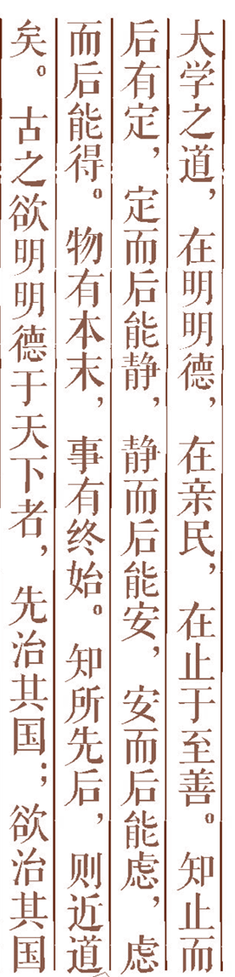
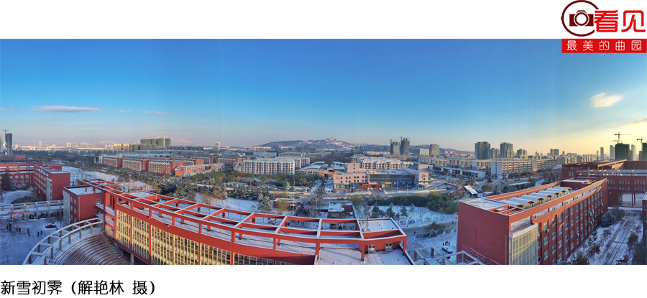

Artificial Intelligence Chapter 18 Machine Learning

Slide 2
Some Quenstions:
How do you learn?
How do you make decisions?
How do you learn concepts such as cat ?

Slide 3


Classification of Learning
A General Framework for Machine Learning
Decision Tree Learning
Version Space Method
Discussion
Outline

Slide 4
1. Classification of Learning
1）Rote learning
2）Learning from instruction
3）Learning by deduction
4）Learning by analogy
5）Explanation-based learning
6）Learning from induction

Slide 5
2.A General Framework for Machine Learning
What is a learning system? 4 characteristics:
Purpose: must know what it is learning.
Structure: The knowledge representation and knowledge organization form can be modified and improved.
Effectiveness: The new knowledge acquired by the system must be beneficial to improving the behavior of the system.
Openness: the ability of a system to evolve over time in its actual use or interaction with its environment.

Slide 6
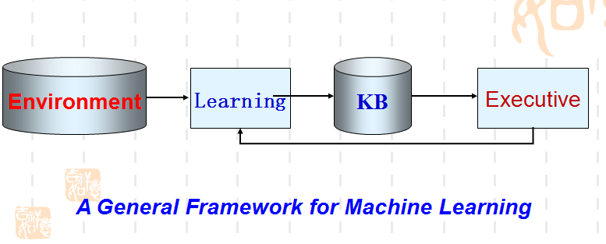
2.A General Framework for Machine Learning

Slide 7
The Environment: is the collection of external information expressed in some form, which represents the source of external information.
The Learning Link: is the process of processing external information into knowledge, it first obtains external information from the environment, then the information is analyzed, synthesized, analogized and induced to form knowledge, which is put into the knowledge base.
Knowledge Base : is a set of knowledge expressed in some form and used to store the knowledge gained in the learning process.
The Executive Link : is the process of using the knowledge in the knowledge base to complete a certain task, and feedback some information to the learning link to guide the further study.

Slide 8
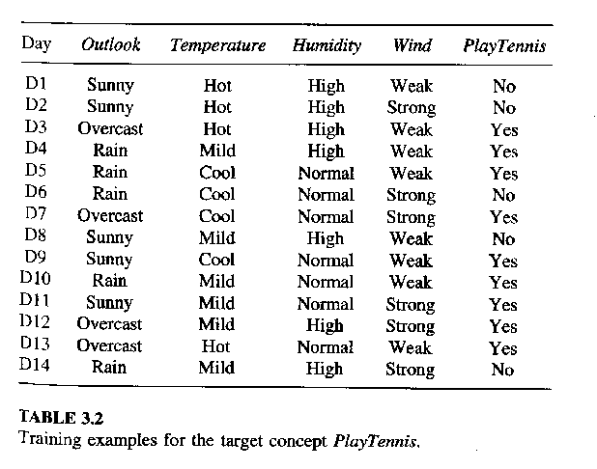
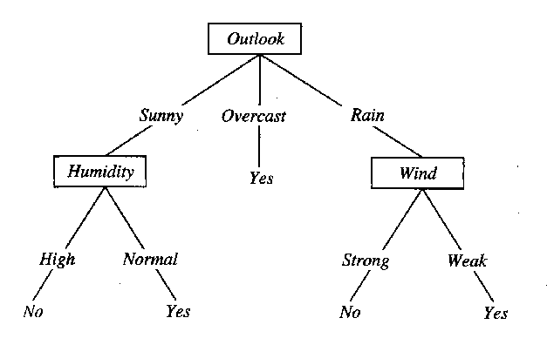
3. Decision Tree Learning
?

Slide 9
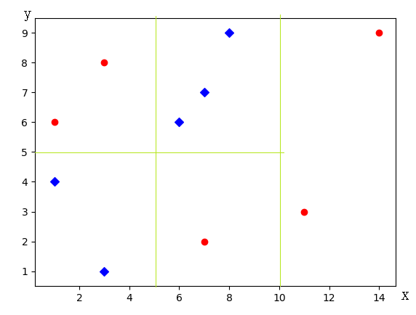
Decision tree corresponding to two-dimensional space segmentation results

Slide 10
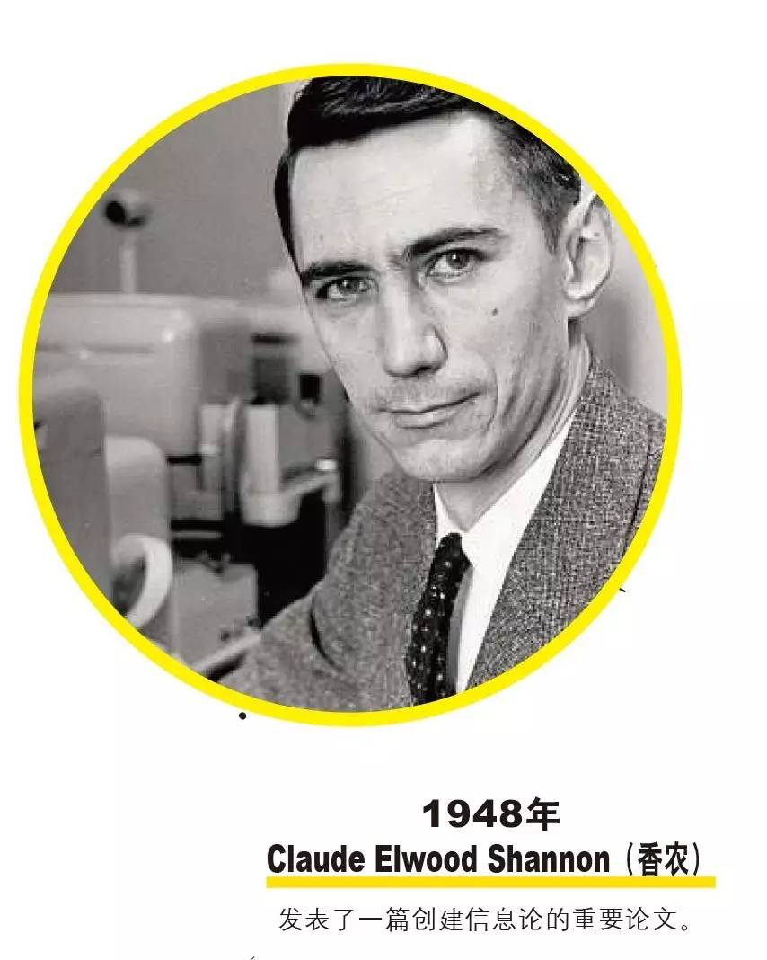
United States
1916-4-30---2001-2 -24
Major achievements:
information theory,
information entropy

Slide 11
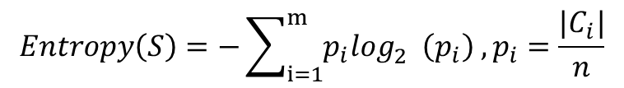
Information Entropy
The more ordered a system is, the lower its entropy is.
The more chaotic a system is, the higher its entropy is.
Exa.1：p₁ = p₂ = ½. H1 = -(1/2)*log₂(1/2) - (1/2)*log₂(1/2) = 1
Exa.2：p₁ = 1/4 p₂ = ¾. H2 = -(1/4)* log₂(1/4) - (3/4)*log₂(3/4)=0.81
Exa.3：p₁ = 1 p₂ = 0. H3 = -1 * log₂1 = 0.

Slide 12
ID3 Algorithm
-- to construct a decision tree whose entropy decreases the fastest.
Optimal classification attribute:

Slide 13
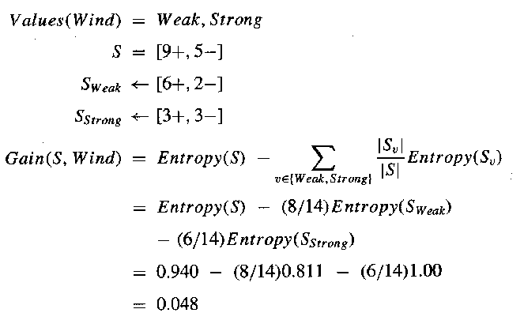
Example 1

Slide 14
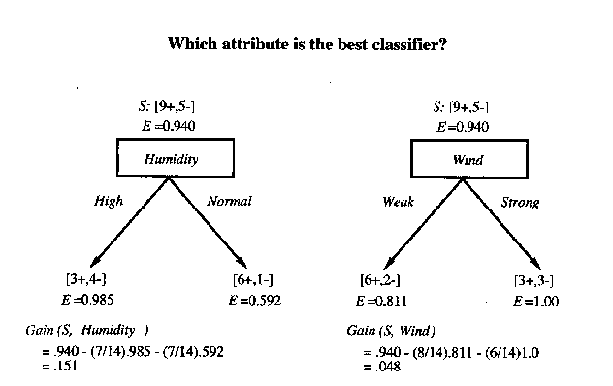

Slide 15
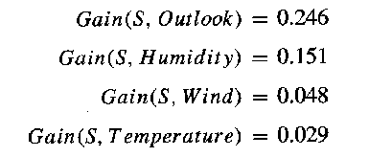


Slide 16
4. Version Space Method
Null description
Rule
Space
Generalization
G
Specialization
S
Training examples

Slide 17
Method
Initial: G is the top point, S is the bottom line (teaching positive example) , H for the whole rule space.
Search Process: G moved down, S moved up, H gradually reduced.
Results: H converg.es to a concept with only one requirement.

Slide 18
Deletion Candidate Algorithm
Initial : G is the most general formal description, H is the entire rule space, S contains all possible teaching examples.
Search Process: receive a new teaching example.
If it is a positive case: remove the concept of not covering the new positive case in G, and then modify S to be the most special result induced by the new positive case and the original elements of S,
If it is a negative case: remove the concept of covering the negative case from S; Then we modify G to be the most general result
Result: G= S and H is a set of only one concept, then outputs the concepts in H.

Slide 19
Example 2
The size of an object is described as large (lg) or small (sm) ; the shape of an object is described as a circle (cir) , square (squ) , or triangle (tri) . If x is the size and y is the shape. Learning the concept of "circle" with the deletion candidate algorithm.
size: lg, sm
shape: cir , squ , tri

Slide 20
Step 1: G={(x,y)}
S={ (sm cir), (lg squ), (lg cir), (sm squ), (sm tri),(lg tri)}
Step 2: (sm cir) positive case
G={(x,y)}
S={ (sm cir)}
Step 3: (lg squ) negative case
S={ (sm cir)}
G={(sm,y),(x,cir)}
Step 4: (lg cir) positive case
G={(x,cir)}
S= {(x,cir)}
G=S.

Slide 21
Exc.
Consider the following properties and values of the building block world:
Color = { yellow, blue, green } Shape = {conical, spherical, rectangle }
Hardness = { hard, soft } Size = {large, small }
to learn the "yellow"
examples:
1. (yellow, conical, soft, large, +)
2. (blue, rectangle, soft, small, -)
3. (yellow, spherical, soft, small, +)
4. (yellow, conical, hard, large, +).
5.(yellow, rectangle, soft, large, +)
6. (green, spherical, hard, large, -)

Slide 22
Method: Formal representation: x for color, y for shape, z for hardness, and m for size
Step 1: G={(x,y,z,m)}, S={(yellow, conical, soft, large)}
Step 2: (blue, rectangle, soft, small) negative case
S={(yellow, conical, soft, large)}
G={(yellow,y,z,m),(x,conical,z,m),(x,y,z,large)}
Step 3: (yellow, spherical, soft, small) positive case
G={(yellow,y,z,m)}
S={(yellow,y,soft,m)}
Step 4: (yellow, conical, hard, large). positive case
G={(yellow,y,z,m)}
S={(yellow,y,z,m)}
Step 5: G=S Output (yellow,y,z,m).

Slide 23
5. Discussion

